Slide 1

STOCK PRICE PREDICTION
Start Presentation
Arpan Goyal(102303479) Nishant kokri(102303481) Akshat goyal(102303475)

Slide 2

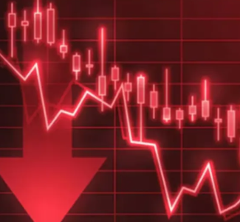
INTRODUCTION
The stock market is a key part of the global economy.
Investors want to know if a stock’s price will go up or down.
Predicting stock prices is hard due to sudden market changes.
Machine Learning can help find patterns in past data to make predictions.

Slide 3
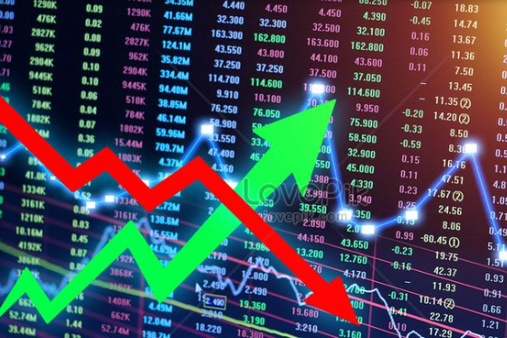
PROBLEM STATEMENT
Stock prices are unpredictable and influenced by many factors.
It’s difficult to forecast price using simple methods.
Our project focuses on predicting the next day’s closing price of Apple stock.
We also want to know whether the price will go up or down (direction).

Slide 4

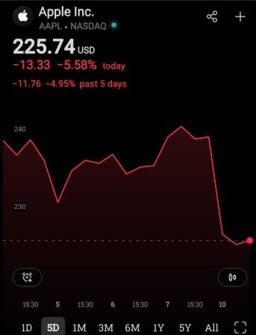
OBJECTIVES
Collect Apple stock data from Yahoo Finance.
Prepare the data by removing missing values and creating new features.
Use three ML models: Linear Regression, Decision Tree, and Random Forest.
Predict the next day’s stock price.
Evaluate the models using error and accuracy metrics.
Compare how well each model performs.

Slide 5
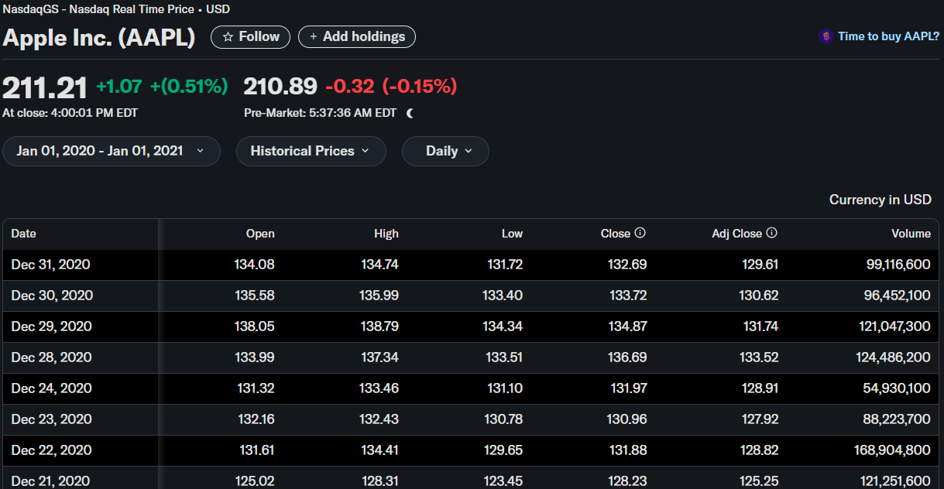
DATASET AND FEATURES
We collected 1 years of Apple stock data (2020–2021).
The dataset includes daily values like:
Open, High, Low, Close, Volume
But we use only essential values i.e close and volume
Our target is the next day’s closing price.

Slide 6
MODELS USED
Linear Regression
Decision Tree
Random Forest
Draws a straight line to fit the data for linear movements
SPLITS THE DATA INTO BRANCHES BASED ON RULES
Builds many decision trees and takes the average resul

Slide 7
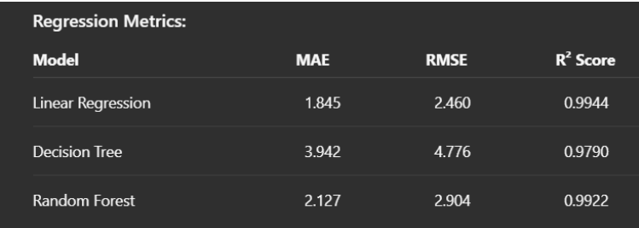
EVALUATION METRICS
MAE (Mean Absolute Error)
Average of all prediction errors.
RMSE (Root Mean Squared Error)
Similar to MAE but penalizes big errors more.
R² Score
Tells how much of the actual data is explained by the model

Slide 8
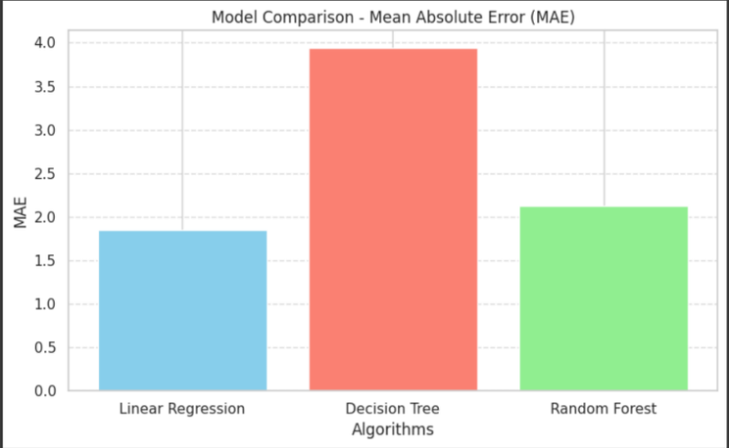
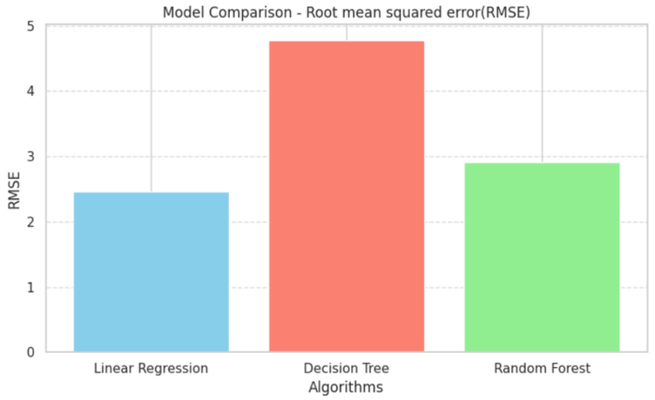
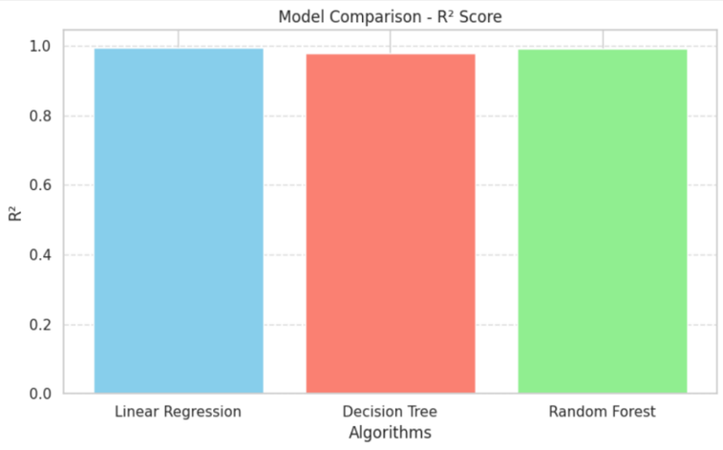
VISUALIZATIONS

Slide 9
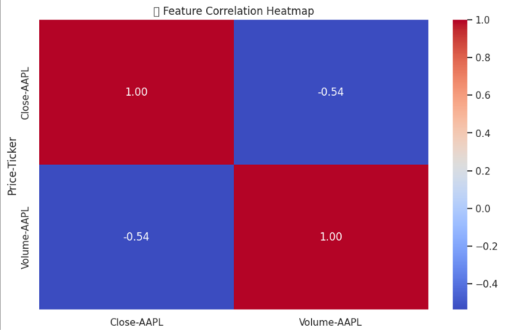
CORRELATION HEATMAP
The heatmap shows the correlation between stock features: Closing Price and Volume
The correlation between Close Price and Volume is -0.54, indicating a moderate negative relationship.
When volume increases, the stock price often decreases.
When the stock price increases, trading volume usually drops.

Slide 10
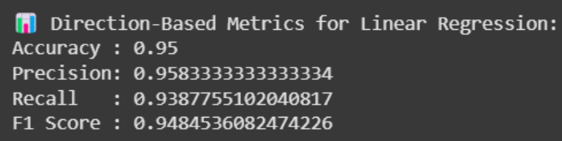
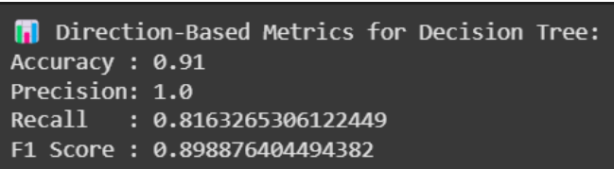
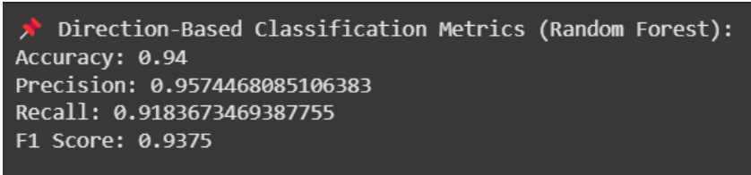
CONCLUSIONS
Machine Learning models can effectively predict stock prices and trends.
Linear Regression performed best due to Apple’s steady and linear price movement.
ML models make forecasting more data-driven and reliable, even though market uncertainty remains
It outperformed more complex models like Decision Tree and Random Forest on this dataset.

Slide 11
FUTURE IMPROVEMENTS
Add Sentiment Analysis
Explore Deep Learning Models
Include data from financial news or social media (like Twitter) to understand public mood and its effect on stock movement.
Try LSTM (Long Short-Term Memory) networks for capturing time-based dependencies in stock prices.
Use Real-time Data
Use More Volatile Stocks
Enhance the model using live data streams for near real-time predictions and decision-making.
Test the models on highly fluctuating stocks like Tesla (TSLA) to evaluate performance in unstable conditions.

Slide 12
THANK YOU

